Slide 1

PREDICTIVE AND PRESCRIPTIVE STATISTICAL MODELS FOR INVENTORY MANAGEMENT IN HEALTH CARE
Presented By:
Mr: Kshirsagar Tushar Deepak (17029)
Mr: Gujar Hrishikesh Ankush (17027)
Mr: Bhoite Nikhil Suryakant (17028)
Guided By:
Miss. N.A.Jagtap

Slide 2
WHY INVENTROY MANAGEMENT SYSTEM FOR HOSPITALS?
It gives real time status of all the available beds, medical equipment's and drugs
Uses
Management of beds, medical equipment's and drug stock
To avoid inconvenient waiting hours in hospitals due to improper management of beds and medical equipment's
Need
To avoid overcrowding of patients during emergencies

Slide 3
Objectives
To propose an innovative machine learning model to predict Recovery Time of patient using Predictive and Prescriptive Analysis.
To determine the factors like Age, Gender, Medical History, Diagnosis etc. which affects the Recovery Time of patients.
To find the best fit model.

Slide 4
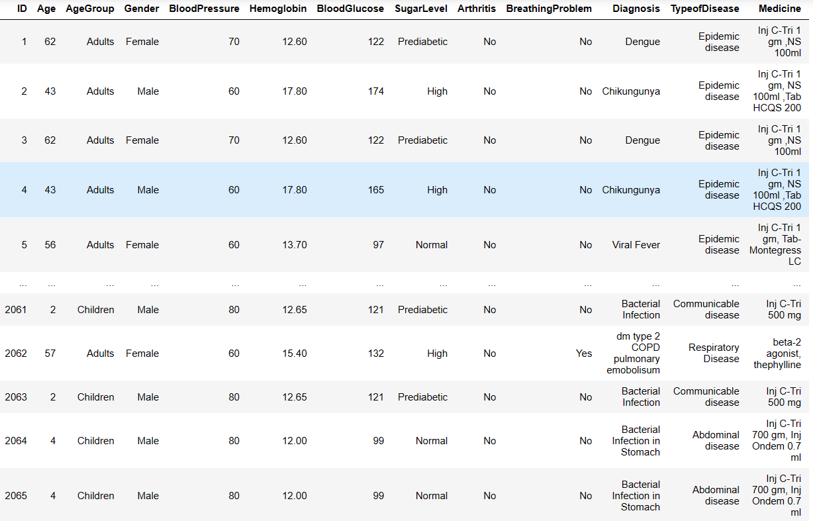
Data Representation

Slide 5
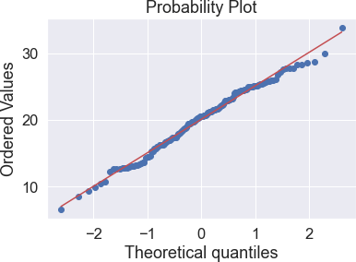
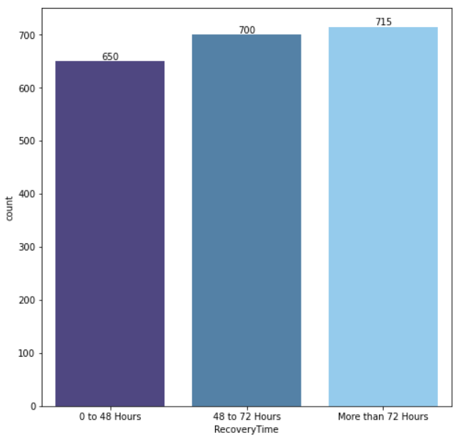
Exploratory Data Analysis
PROBABILITY PLOT
COUNT PLOT OF TARGET VARIABLE

Slide 6
BAR PLOT FOR AGE GROUP
BAR PLOT FOR GENDER

Slide 7
BAR PLOT FOR SUGAR LEVEL
BAR PLOT FOR LOCALITY

Slide 8
BAR PLOT FOR TYPE OF DISEASE

Slide 9
PIE CHART OF RECOVERY TIME OF PATIENT

Slide 10
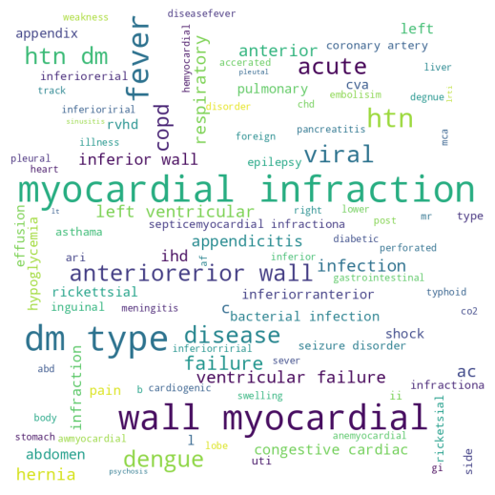
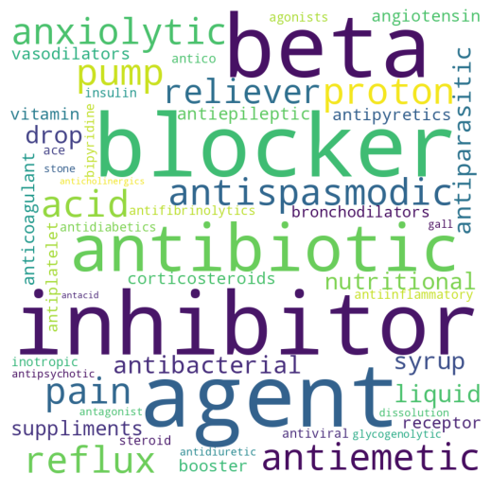
WORD CLOUD FOR DISEASE
WORD CLOUD FOR TYPE OF MEDICINES

Slide 11
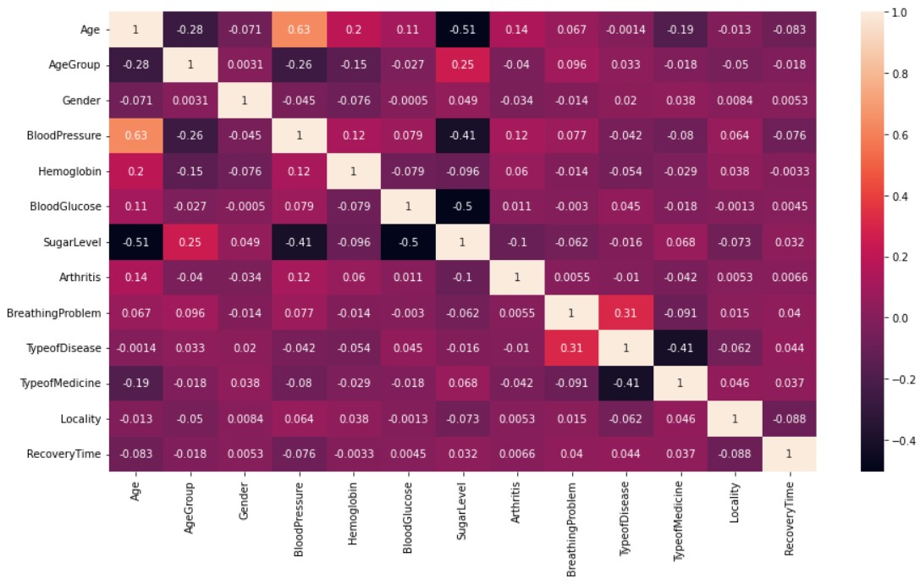
CORRELATION PLOT

Slide 12
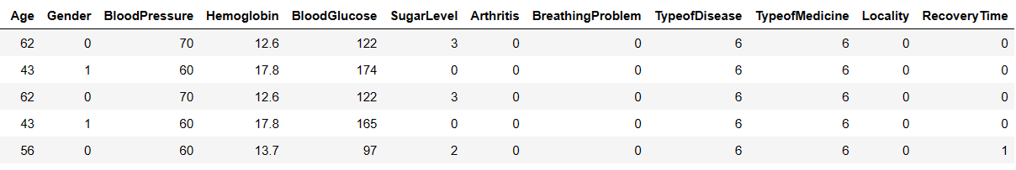
Diagnostic Statistical Model
The above data consist of some important features and their description is explained below:
Age: The complete age of patient in years.
Gender: In this feature, there are two classes on the basis of whether the patient is Male or Female.
Female: - “0”
Male: - “1”
Blood Pressure: Blood pressure is the measurement of the pressure or force of blood inside your arteries. Each time your heart beats, it pumps blood into arteries that carry blood throughout your body. This happens 60 to 100 times a minute, 24 hours a day. Arteries deliver oxygen and nutrients to your whole body so it can function.

Slide 13
Hemoglobin: Hemoglobin (Hb) is the protein contained in red blood cells that is responsible for delivery of oxygen to the tissues. To ensure adequate tissue oxygenation, a sufficient hemoglobin level must be maintained. The amount of hemoglobin in whole blood is expressed in grams per deciliter (g/dl). The normal Hb level for males is 14 to 18 g/dl; that for females is 12 to 16 g/dl. Old Peak: ST depression induced by exercise relative to rest.
Blood Glucose: Blood glucose, or blood sugar, is the main sugar found in your blood. It is your body's primary source of energy. It comes from the food you eat. Your body breaks down most of that food into glucose and releases it into your bloodstream. When your blood glucose goes up, it signals your pancreas to release insulin. Insulin is a hormone that helps the glucose gets into your cells to be used for energy.
Sugar Level: In this feature, there are four classes on the basis of sugar level of patient.
High: - “0”
Low: - “1”
Normal: - “2”
Prediabetic: - “3”

Slide 14
Arthritis: Arthritis means joint inflammation. Arthritis is a medical condition in which the patient feels swelling and pain in their joints. Among adults aged 18 to 44. 7.1% ever reported having diagnosed with arthritis, and adults aged 45 to 64 29% reported having diagnosed with arthritis.
No: - “0”
Yes: - “1”
Breathing Problem: In this feature, we have taken two classes on the basis of patient having breathing problem or not.
No: - “0”
Yes: - “1”
Type of Disease: In this data, there are total 10 different types of disease. Epidemic Disease, Bacterial Infection, Kidney Disease, Neurological Disorder, Long Term Disease, Communicable Disease, Respiratory Disease, Abdominal Disease, Heart Disease, and Viral Disease.

Slide 15
Type of Medicines: The data consist of total 41 various types of Medicines. Antibiotic, Anti-inflammatory, Proton Pump Inhibitor, Antispasmodic, Acid reflux, Antacid, Antiemetic, Anxiolytic, Pain Reliever, Antibacterial, Drop, Syrup, Antiphrastic, Liquid, Nutritional Supplements, Antiepileptic, Anticoagulant, Corticosteroids, Vasodilators, Antipyretics, Vitamin Booster, Angiotensin receptor blocker, Bronchodilators, Antiplatelet, Antifibrinolytics, Beta Blockers, ACE Inhibitors, Antidiabetics, Beta Agonists, Antico, Steroid, Bipyridine Inotropic, Antiviral, Insulin, Glycogenolytic Agent, Antidiuretic, Antagonist, Antipsychotic, Gall Stone Dissolution Agents, and Anticholinergics.
Locality: In this feature, there are two classes on the basis of patient’s residence.
Rural: - “0”
Urban: - “1”
Recovery Time of patient: The target feature consists of, in how much time a patient will recover, in this feature there are three classes of recovery time.
0 to 48 Hours: - “0”
48 to 72 Hours: - “1”
More than 72 Hours: - “2”

Slide 16
CHI-SQUARED TEST FOR DEPENDENCY AND INDEPENDENCY OF FEATURES
FEATURES | Result
Recovery Time and Age Group | Independent
Recovery Time and Gender | Independent
Recovery Time and Sugar Level | Dependent
Recovery Time and Breathing Problem | Independent
Recovery Time and Type of Disease | Dependent

Slide 17
MODEL BUILDING
Data
Training Data
80%
Testing Data
20%
Models built on Training Data
Decision Tree
Accuracy 83%
Random Forest
Accuracy 85%
Gradient Boosting
Accuracy 75%
Ada Boost
Accuracy 84%

Slide 18
Model Comparison
Model | Accuracy | Precision | Recall | F1 score
Random Forest | 85% | 85% | 85% | 85%
Ada boost | 84% | 84% | 84% | 84%
Decision Tree | 83% | 84% | 83% | 83%
Gradient Boosting | 75% | 75% | 74% | 74%

Slide 19
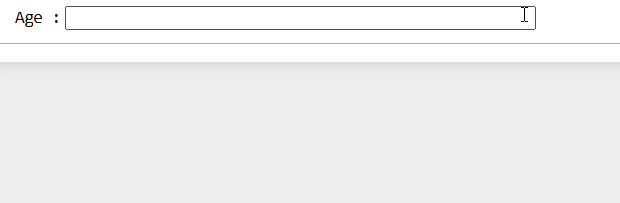
How Does This Model Work?

Slide 20
Scope & Limitations
SCOPE
In this study, we have proposed an innovative machine learning model which can be very helpful for all local and multispecialty hospitals, so they can avoid the crowding and effectively manage all necessary inventories in their ward.
This model can also be very helpful for Government Hospitals. From this study, Government Hospitals can change their policies towards inventory management system, so common people will get all the necessary medical services in government hospitals.
LIMITATIONS
In this study, we have collected the data from a single hospital but which is not enough for being this model as global solution for inventory management system.
This study is based only on handful of diseases and the data is collected from a hospital belonging to specific city.

Slide 21
THANK YOU….

